Slide 1

National roll out of the TARGET Toolkit
Community Pharmacy West Yorkshire

Slide 2

Workshop agenda
Context and background of antimicrobial resistance
Improving our antibiotic prescribing
  Strategies and resources
  Evidence for using the TARGET resources
  Clinical scenario
The link between antibiotic prescribing and resistance in your patients
Benefits of reducing antibiotic prescribing on AMR and on patient consultations
Questions – Pop them in the Q&A
www.rcgp.org.uk/TARGETantibiotics

Slide 3
Learning Outcomes
By the end of this workshop, you should have a clear understanding of…
The consequences of antimicrobial resistance and the role we all play in contributing to, and addressing AMR
  Links to West Yorkshire system ambition
The TARGET toolkit and how it can support you - where to find it and how to use it
What you, and your practice, can do to help tackle AMR safely and responsibly
  Supporting safe, confident antibiotic decisions in Pharmacy First
  Reducing unwarranted variation
  Strengthening GP–community pharmacy interface
www.rcgp.org.uk/TARGETantibiotics

Slide 4
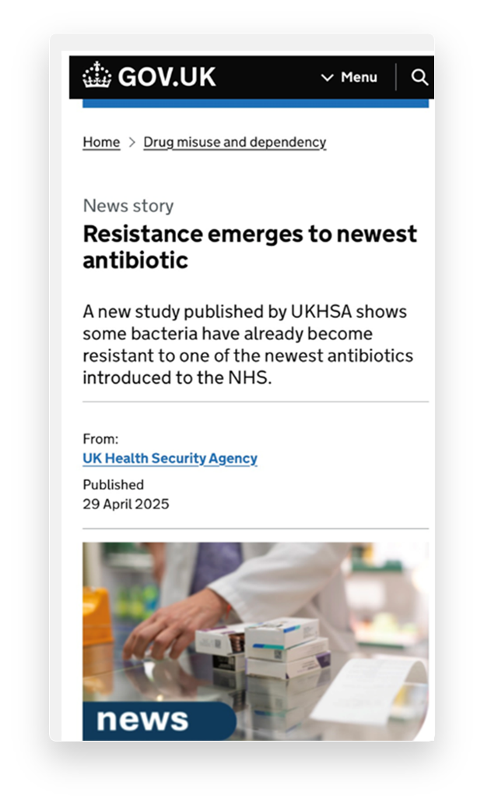
TARGET Antibiotics
“There are few public health issues of potentially greater importance for society than antibiotic resistance”
2013 CMO Prof Dame Sally Davies
www.rcgp.org.uk/TARGETantibiotics
Notes:
Although this quote from Dame Sally Davies is now over a decade old, it remains just as relevant today as it was when it was first said.
Antimicrobial resistance continues to pose one of the biggest threats to global health.

Slide 5
TARGET Toolkit Brief Overview
Professor Philip Howard, OBE
AMR Regional Antimicrobial Stewardship Lead
NHS England North-East & Yorkshire

Slide 6
Why TARGET remains central to AMS
We are working collaboratively with UKHSA to disseminate TARGET toolkit training across England to support achievement of;
UK AMR National Action Plan objectives
NHSE AMS objectives
A 2018 evaluation of the TARGET training showed;
80% (217/269) of respondents said the workshop helped them to understand how they could optimise their antimicrobial prescribing
88% (237/269) responded that the workshop helped them to understand why responsible antimicrobial prescribing was an important issue
Notes:
TARGET stands for Treat Antibiotics Responsibly, Guidance, Education and Tools.
The TARGET Antibiotics Toolkit is a suite of resources aimed at primary care providers to support appropriate antibiotic prescribing.
NHS England are working collaboratively with UKHSA to roll out TARGET toolkit training to highlight and support antimicrobial stewardship, aligning with the objectives of the UK Antimicrobial Resistance National Action Plan.
The toolkit is hosted on the RCGP website and is freely available — you do not need to be an RCGP member to access the resources.
The toolkit has been available since 2009 and is regularly reviewed and updated in line with current NICE prescribing guidelines.
Previous evaluations have shown that when TARGET training is delivered alongside use of the resources, antibiotic prescribing in primary care can be reduced.
References/links
¹ Cliodna McNulty, Meredith Hawking, Donna Lecky, Leah Jones, Rebecca Owens, André Charlett, Chris Butler, Philippa Moore, Nick Francis, Effects of primary care antimicrobial stewardship outreach on antibiotic use by general practice staff: pragmatic randomized controlled trial of the TARGET antibiotics workshop, Journal of Antimicrobial Chemotherapy, Volume 73, Issue 5, May 2018, Pages 1423–1432, https://doi.org/10.1093/jac/dky004
UK 5-year action plan for antimicrobial resistance 2024 to 2029 - GOV.UK
UK 5-year action plan for antimicrobial resistance 2019 to 2024 - GOV.UK (www.gov.uk)
Tackling antimicrobial resistance 2019 to 2024: addendum to the UK's 5-year national action plan - GOV.UK (www.gov.uk)

Slide 7
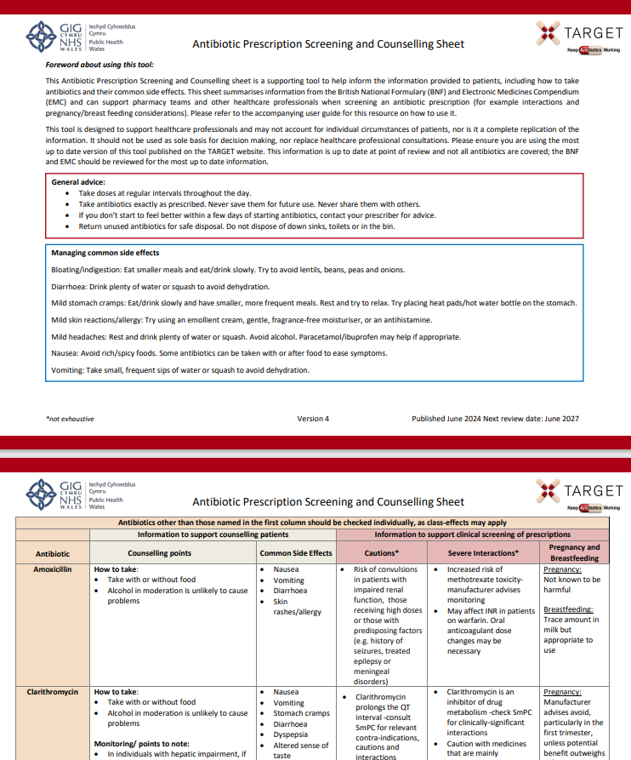
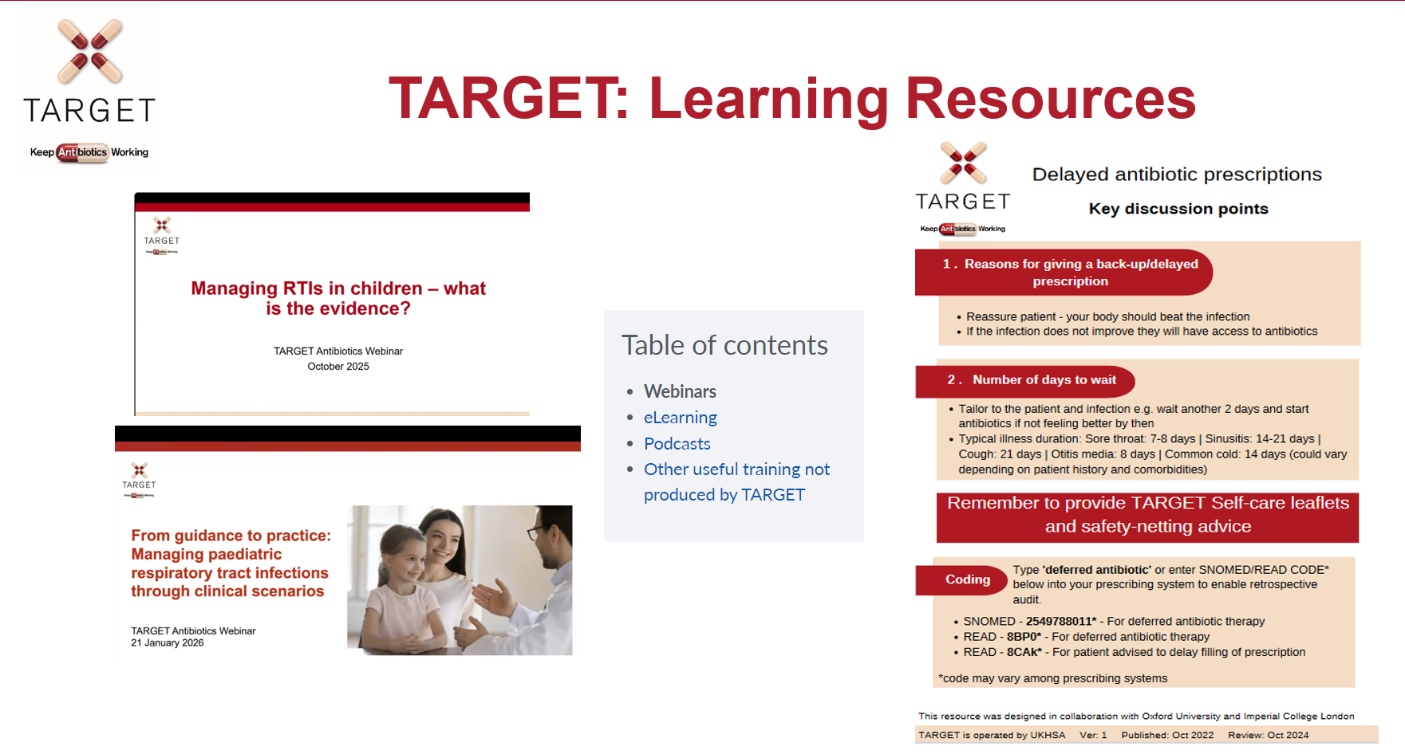
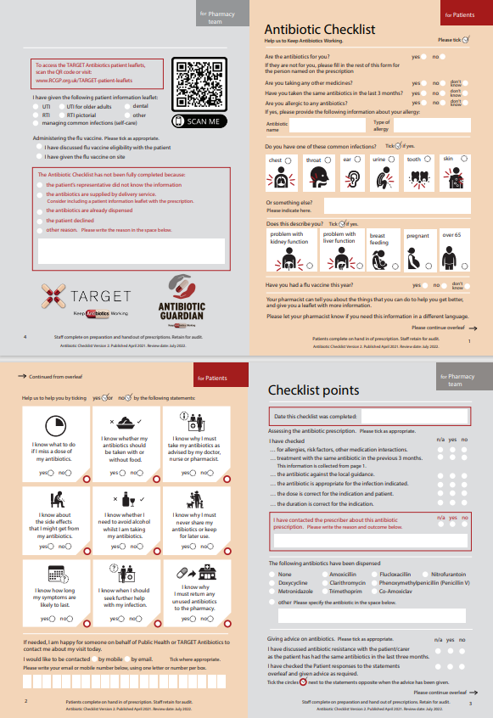
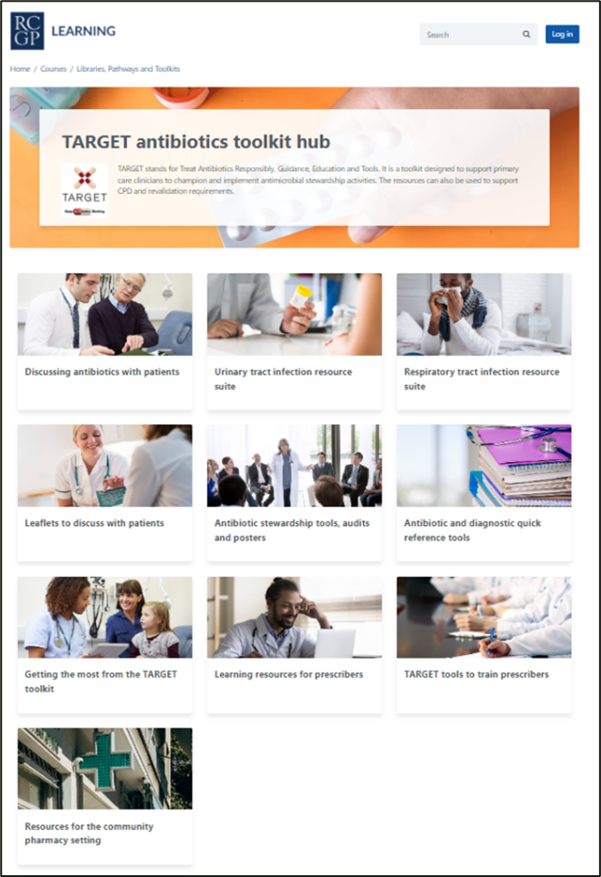
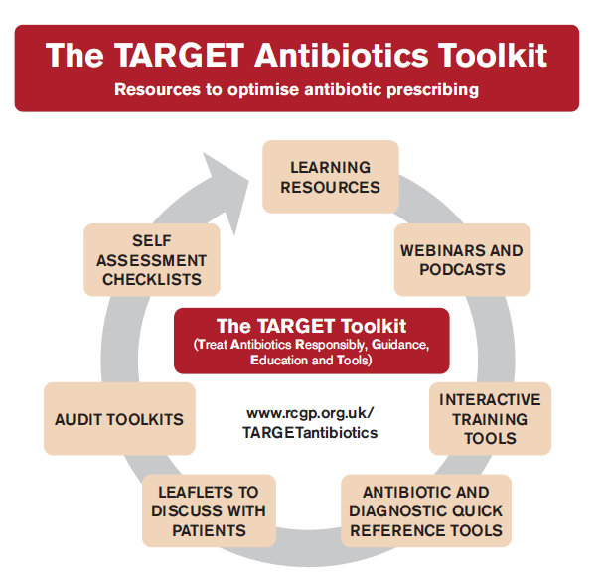
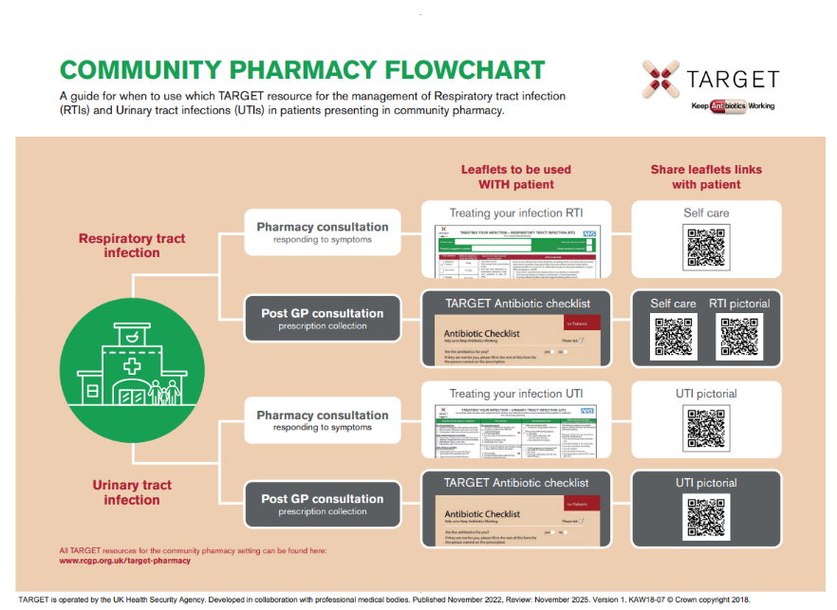
TARGET toolkit
How TARGET supports consultations and decisions
www.rcgp.org.uk/TARGETantibiotics
Notes:
The toolkit is divided into ten sections.
Each section contains links to guidance, resources and supporting information.
There is also a specific section for community pharmacy, which supports pharmacists in providing consistent evidence-based messaging about antibiotic use, infection prevention, safety-netting and self-care advice.
Resources include:
• the community pharmacy infection flowchart
• the TARGET antibiotic checklist for patients collecting antibiotics
• the counselling checklist summarising advice from the BNF and electronic medicines compendium.
These tools help pharmacy teams support patients when screening antibiotic prescriptions and providing counselling. The website also hosts a range of short training webinars and supporting materials, which can be used by pharmacy teams and other primary care clinicians to support learning and implementation of antimicrobial stewardship.

Slide 8
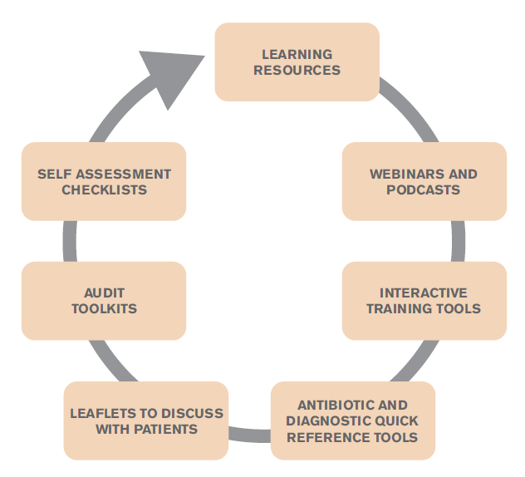
COM-B Model
Capability
Behaviour;
Responsible antibiotic use
Motivation
Opportunity
REF COM-B
Notes:
All TARGET resources have been developed using behavioural science models such as COM-B — capability, opportunity and motivation leading to behaviour.
Research shows that if we want to improve antibiotic supply, we need to address these behavioural drivers — knowledge, confidence, opportunity and patient expectations.
References/links
TARGET Antibiotic Toolkit - Course: TARGET antibiotics toolkit hub (rcgp.org.uk)
Theory of Planned Behaviour -
COM-B -

Slide 9
Why TARGET – Why Now?

Slide 10
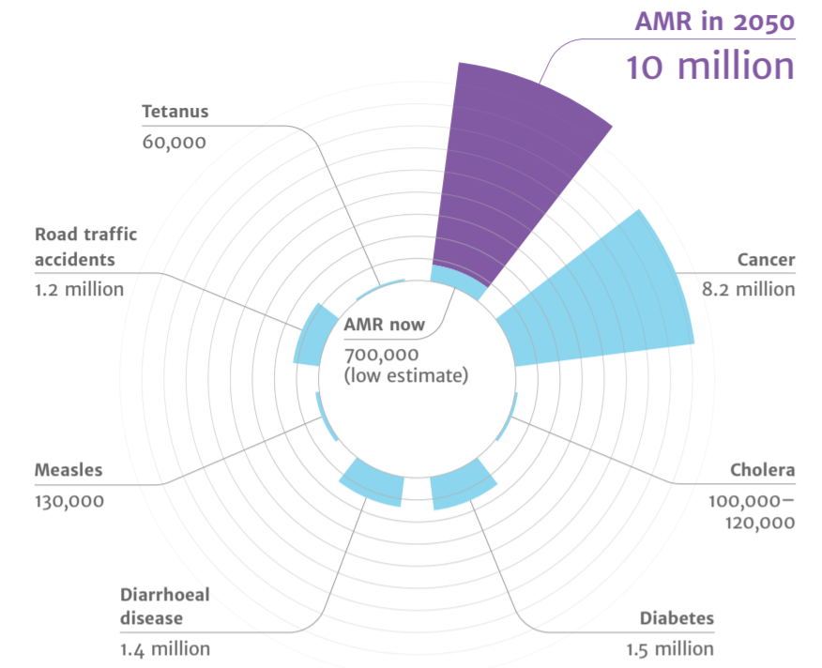
Deaths attributable to AMR each year
Context
AMR
2050
Diabetes
and cancer
combined
AMR in 2050
10 million
Tetanus
60,000
10,000,000
Road traffic accidents
1.2 million
9,700,000
Cancer
8.2 million
AMR now
700,000
(low estimate)
Cholera
100,00 – 120,000
Measles
130,000
Diarrhoeal disease
1.4 million
Diabetes
1.5 million
(O ’Neill, 2015)
Notes:
A United Nations report estimated that by 2050 antimicrobial resistance could cause up to 10 million deaths per year in the worst-case scenario — more than diabetes and cancer combined.
Whilst statistics like this can feel distant from everyday practice, they reflect a growing global challenge for healthcare systems.
Reference:
https://amr-review.org/sites/default/files/Antimicrobials%20in%20agriculture%20and%20the%20environment%20-%20Reducing%20unnecessary%20use%20and%20waste.pdf

Slide 11

The Iceberg of Gram Negative Resistance
Carbapenemases<2%
ESBL
Some resistance
Sensitive
www.rcgp.org.uk/TARGETantibiotics
Notes:
A survey in England found that around 7% of the population carried ESBL-producing E. coli in their gut.
Globally we also continue to see emerging resistant organisms — such as the extensively drug-resistant typhoid strain reported in Pakistan.
Closer to home many of you will have seen increasing resistance in urinary tract infections to trimethoprim.
Resistance develops when bacteria are repeatedly exposed to antibiotics and the organisms that survive that exposure go on to spread.
Which means the way antibiotics are used across healthcare — including in community pharmacy — plays an important role in slowing that process.

Slide 12
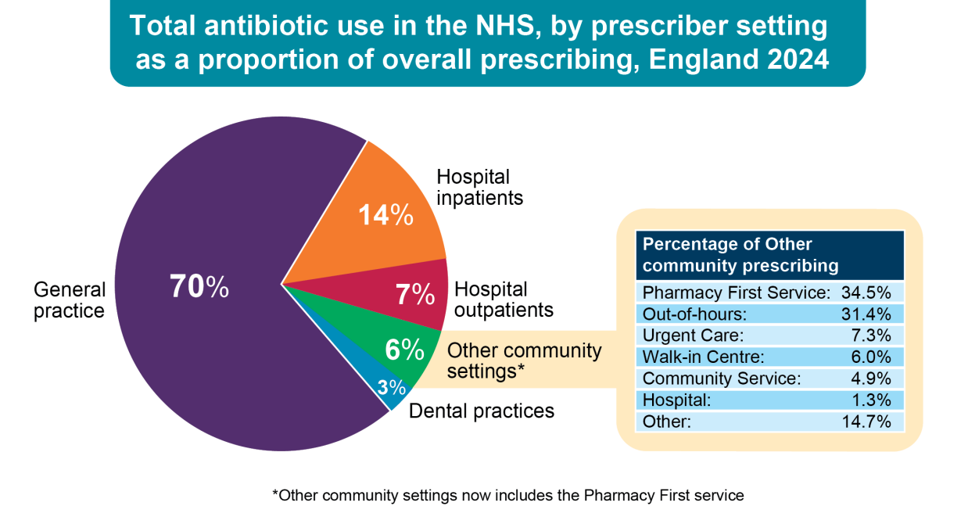
UK prescribing: most antibiotics are prescribed in the community
ESPAUR Report 2021
(ESPAUR Report, 2024-2025)
Notes:
In England most antibiotics are still prescribed in primary care settings, particularly general practice.
Encouragingly, antibiotic prescribing began to fall from around 2015 and this trend has continued.
However antibiotics remain widely used across the healthcare system.
At the same time, we are seeing changes in how patients access care in the community.
With services such as Pharmacy First, community pharmacies are increasingly becoming a first point of contact for patients with common infections.
Antimicrobial stewardship is no longer just about prescribing decisions in GP surgeries — it increasingly involves clinical decision-making across the whole primary care pathway, including community pharmacy.

Slide 13
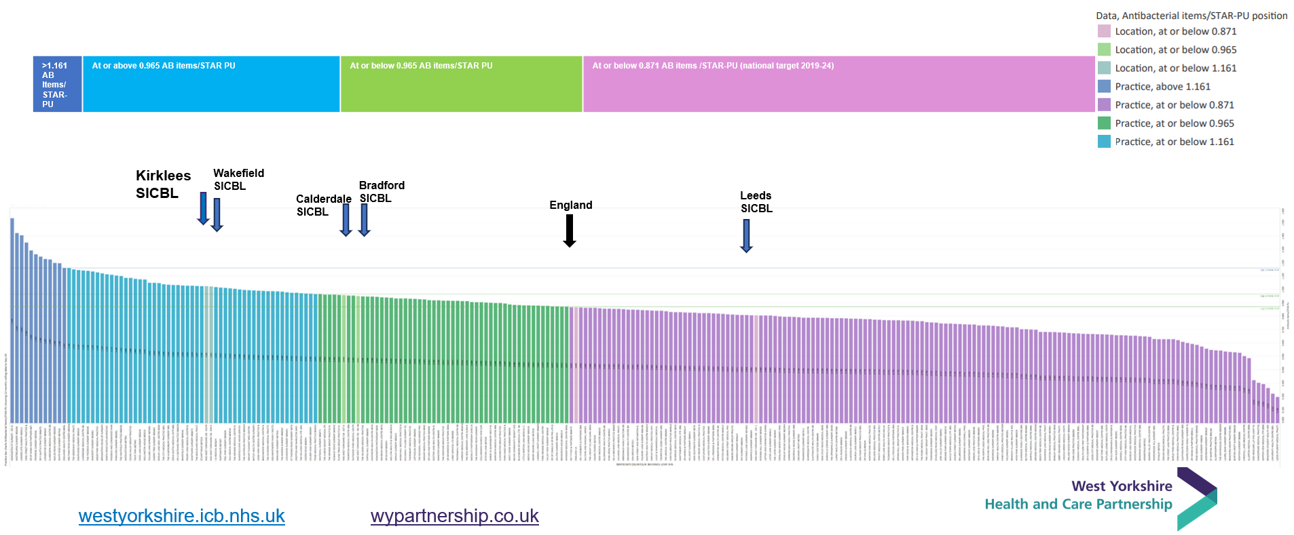
GP Practice bar charts
Antibacterial items/STAR-PU
12 months rolling data to Sep-25
https://www.prescqipp.info/our-resources/webkits/antimicrobial-stewardship/ams-visual-analytics-to-support-nhs-antimicrobial-stewardship-improvement-2024-25/
Notes:
This graph shows prescribing variation between GP practices in West Yorkshire.
Even within a single region there is significant variation in antibiotic prescribing.
That variation tells us there is real opportunity to improve how antibiotics are used.
And if antibiotic use drives resistance, the key moment where we influence that is the consultation itself - increasingly happens in community pharmacy.

Slide 14
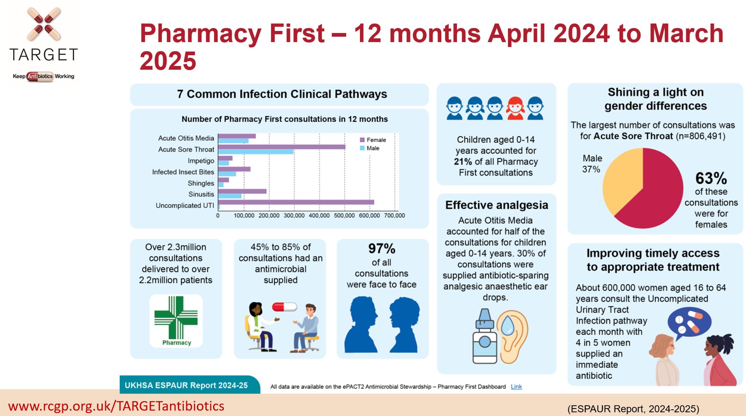
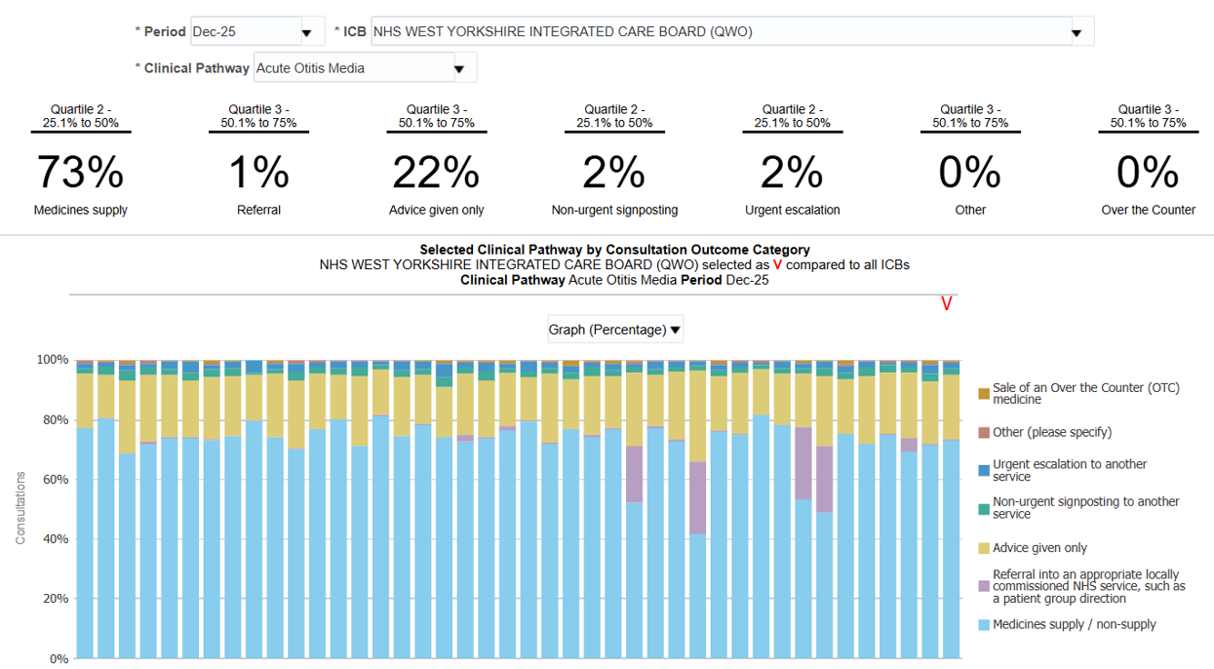
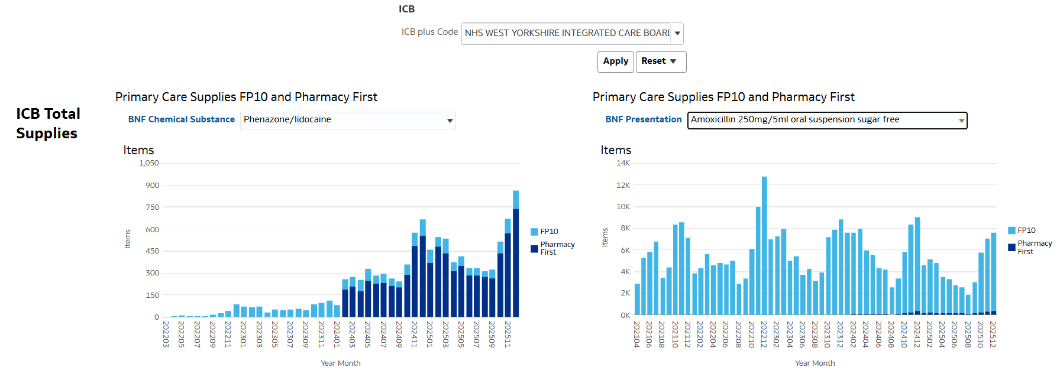
Pharmacy First is Changing Where Infection Care Happens including both antibiotics and non-antibiotic treatments
Data Source: https://openprescribing.net/icb/QWO/doxy_100_6_qty/
Notes:
Speaker:
Time:
Presenter notes:
These graphs give us an early picture of how Pharmacy First is beginning to change access to treatment in primary care.
The first graph shows prescribing and supply for several common infections. What we can see is that as Pharmacy First consultations increase, some treatment that might previously have resulted in an FP10 prescription from general practice is now being managed directly in community pharmacy.
Importantly, this includes both antibiotics, but also non-antibiotic treatments like otigo ear drops and hydrogen peroxide. So pharmacists are not only supplying treatment where appropriate — they are also helping support self-care and alternative management where antibiotics are not needed.
This graphic from the ESPAUR report shows the scale of Pharmacy First consultations up to March 2025.
It highlights just how many consultations are already taking place in community pharmacies, particularly for children.
acute otitis media accounts for over half of consultations in children aged 0–14
Alongside general practice, community pharmacy is increasingly becoming a first point of contact for patients with infections.
With services such as Pharmacy First, pharmacists are often the first clinicians’ patients speak to about their symptoms.
community pharmacy now has a key role in antimicrobial stewardship across primary care.

Slide 15
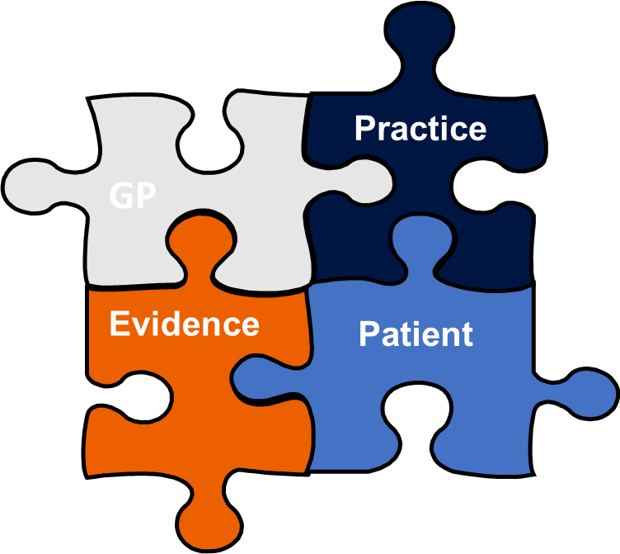
Getting the Decision Right
Assessment and Consultation
Eleanor Barnes, Lead Clinical Pharmacist
Trust Primary Care Ltd and the West Yorkshire Primary Care Workforce & Training Hub
Fiona Burns, Lead Independent Prescriber and DPP at Pharmacy Plus Health.
Deputy Chair and PCN Lead Pharmacist for 5 Lane Ends Community Partnership.

Slide 16
Reflective question – Why do antibiotics get supplied?
Think about the last few respiratory infection consultations you saw…
Why did that patient receive an antibiotic?
www.rcgp.org.uk/TARGETantibiotics
Notes:
Think about the last respiratory infection consultations you managed.
Why did that patient receive an antibiotic?

Slide 17
Drivers of Antibiotic Expectations in Consultations
Why do antibiotics sometimes get supplied when they may not be needed?
Common drivers include:
Perceived patient expectation
Wanting to relieve symptoms quickly
Concern about complications or missing something serious
Time pressures in busy consultations
Example: coloured phlegm alone does not necessarily indicate bacterial infection.
www.rcgp.org.uk/TARGETantibiotics

Slide 18
Pharmacy first: Access • Trust • Stewardship
ACCESS
No Appointment necessary
Accessible when GP capacity is limited
Clinical assessment within Pharmacy First Pathways
Opportunity to influence antibiotic expectations
TRUST
Pharmacists know their local patients
High patient Trust – opportunity for continuity and reassurance
STEWARDSHIP
Shape expectations
Support self-care and symptom management
Reinforce safe antibiotic use and AMR Awareness

Slide 19
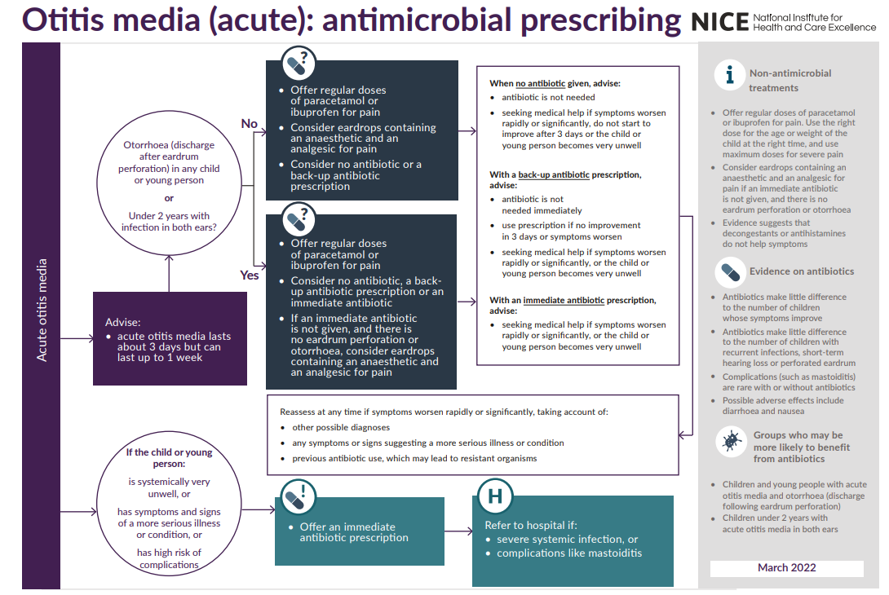
Fear of complications
Serious complications after URTI are rare
Sore throat and otitis media NNT>4000
Pneumonia more common after LRTI
  >65 years: NNT 39
  < 65 years: NNT >100
  Highlighted in NICE summary tables
www.rcgp.org.uk/TARGETantibiotics
Notes:
NICE evidence shows that the number needed to treat with antibiotics to prevent one complication in sore throat or otitis media is over 4000.
So while complications are possible, the overall risk remains very low for most patients.

Slide 20
Pharmacy Assessment – who needs referral
Clinical assessment remains essential
Identify red flag symptoms
Consider NEWS2 scoring if ≥2 concerning observations
Recognise higher-risk groups, including:
  Immunocompromised patients
  Frail or elderly patients
  Significant comorbidities
www.rcgp.org.uk/TARGETantibiotics

Slide 21
Structuring the Consultation
Clinical Assessment
History Taking
Observation
Identify Risk
Red Flag Symptoms
NEWS2 if indicated
Target Treatment
Use Pharmacy first Clinical Pathways
Follow PGD criteria
Higher–risk patients
Manage Safely
Self Care Advice
Analgesia
Delayed Strategies
Safety-Net
Explain when to return
Escalation triggers
Community pharmacists play a key role in reassurance, monitoring, and appropriate referral.

Slide 22
Consultation skills that reduce unnecessary supply:
Focused history taking – start with an open question (“golden minute”)
Careful clinical observation – how does the patient appear?
Using clinical tools appropriately e.g. FeverPAIN, NEWS2
Avoiding early diagnostic tunnelling
Structured physical examination within Pharmacy First pathways
Good consultations support safe antimicrobial stewardship and appropriate referral.
Antibiotic supply must follow the national clinical pathways & PGD criteria.

Slide 23
Key Actions for effective consultations
Address the patient / parent / carer’s concerns and expectations
Communicate the expected duration of symptoms
Provide clear safety-netting advice
Be confident in clinical decisions and refer when needed
Reflect, learn and work with colleagues across primary care
www.rcgp.org.uk/TARGETantibiotics

Slide 24
Community Pharmacy support with reducing use of antibiotics in children
Clinical Scenario: Acute Otitis media
Dr Graham Duce
GP Partner, & Clinical and Prescribing Lead for Cheshire and Merseyside ICB

Slide 25
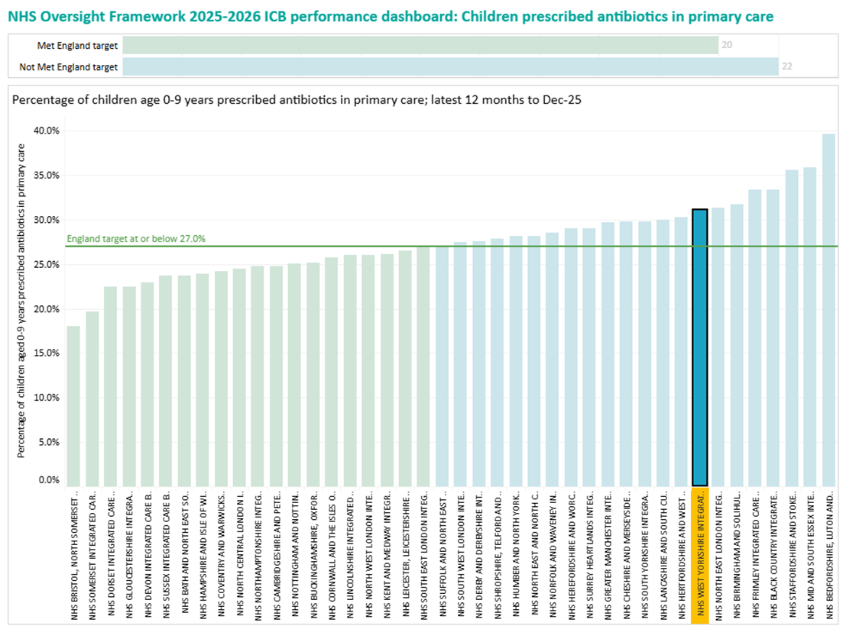
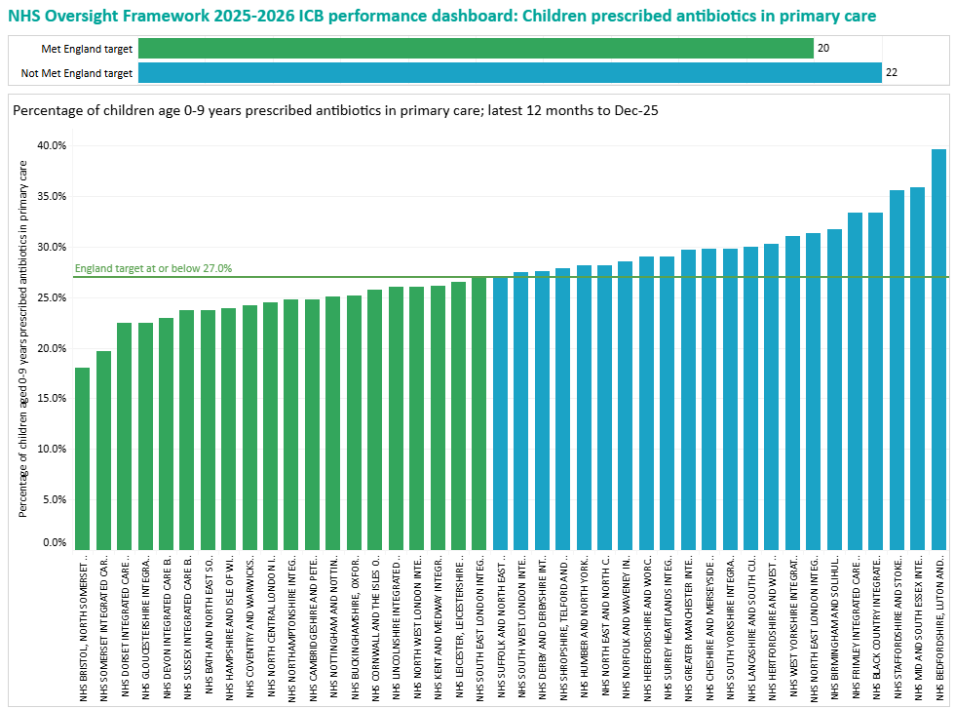
Children Prescribed Antibiotics in Primary Care
Notes:
This graph shows the percentage of children aged 0–9 receiving antibiotics in primary care over the last 12 months.
What it highlights is that prescribing varies quite widely across regions. When we look specifically at West Yorkshire, we can see it sits towards the higher end of prescribing nationally – in fact we are the highest within the North East and Yorkshire region.

Slide 26
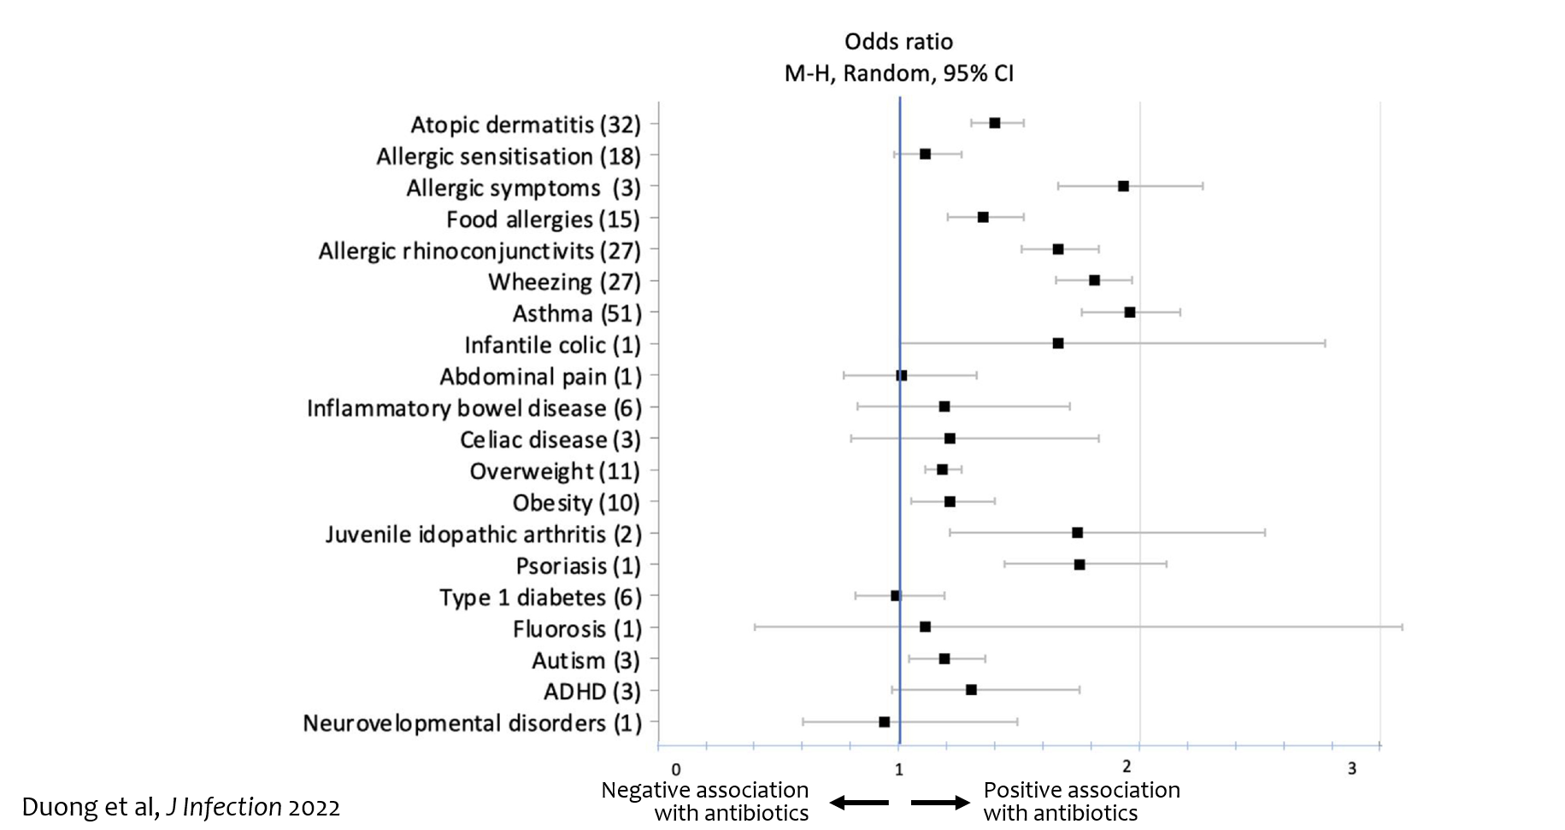
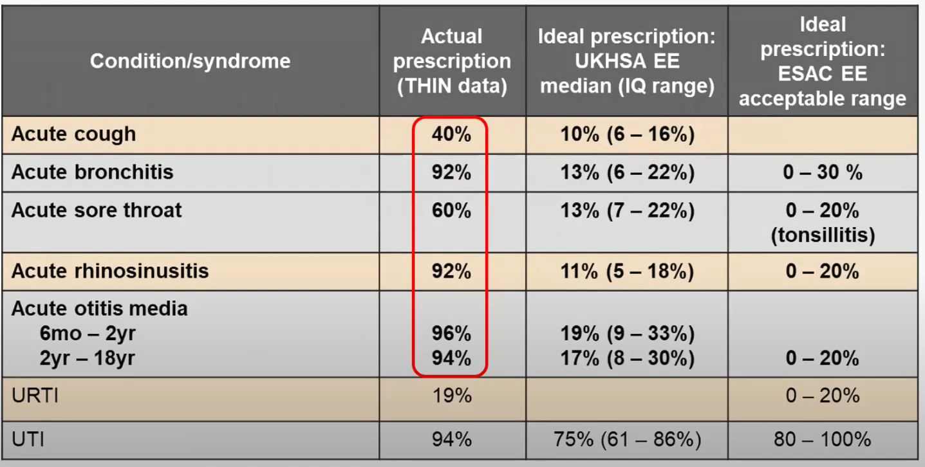
Which Conditions Are Driving Paediatric Antibiotic Use?
Most are self-limiting respiratory infections.
AOM is a major contributor
[Add in link to study]
Notes:
evidence tells us that most paediatric antibiotic use relates to common respiratory infections like acute otitis media.
There is growing evidence that early antibiotic exposure is associated with a range of longer-term health outcomes.
These include effects on growth, such as weight and height, and increased risks of conditions like eczema, asthma and obesity.
There are also associations with autoimmune conditions, such as juvenile idiopathic arthritis and psoriasis, and emerging links with neurodevelopmental outcomes.
These are associations rather than direct causation, but they reinforce an important point: when antibiotics are unlikely to help, avoiding them is not just safe — it may be beneficial in the longer term.
References
Duong et al, J Infection 2022 meta-analysis of 160 studies, 21 outcomes among 22 million children

Slide 27
Prevention reduces infections and antibiotic need
Vaccination helps reduce infections (including AOM):
Pneumococcal vaccination (PCV) → reduces vaccine-type AOM
Annual flu vaccination → reduces URTIs and ear infections
RSV prevention → strengthens protection in early life
Why this matters:
Fewer infections → fewer consultations
Fewer AOM episodes → fewer antibiotic prescriptions
Role for community pharmacy:
Promote flu vaccination
Support uptake of routine childhood vaccines
Reinforce prevention and self-care messages
GOV.UK UKHSA routine schedule (2026); UKHSA flu programme (2025–26); NHS England nirsevimab rollout (2025);
CID 2025; BMC Infect Dis 2026; Frontiers 2024.
Notes:
References:
Sources: GOV.UK UKHSA routine schedule (2026); UKHSA flu programme (2025–26); NHS England nirsevimab rollout (2025); CID 2025 (RSV → ↓AOM); BMC Infect Dis 2026 (PCV & AOM); Frontiers 2024 (OM pathogens).

Slide 28

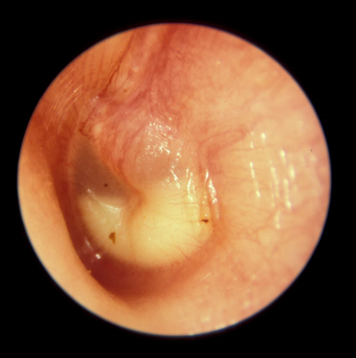
Clinical scenario:
Acute Otitis Media
Clinical Scenario
Acute Otitis Media
Consider the following details:
5 year old boy screaming with pain in left ear.
No history of fever, temp 37.4°C.
Not vomiting.
Paracetamol helps but pain returns before next dose due.
Had AOM this time last year.
Right ear drum bulging and red.
Had antibiotics last time and mother very keen to have antibiotics again.
www.rcgp.org.uk/TARGETantibiotics
Notes:
References / Evidence
Rovers MM, Glasziou P, Appleman CL, Burke P, McCormick DP, Damoiseaux RA, Little P, Le Saux N, Hoes AW. Predictors of pain and/or fever at 3 to 7 days for children with acute otitis media not treated initially with antibiotics: a meta-analysis of individual patient data. Pediatrics 2007;119(3):579-85
RATIONALE: The risk of prolonged illness was 2 times higher for children <2years with bilateral AOM than for children with unilateral AOM. For this sub-group parents should be advised that symptoms may persist for up to 7 days, and they should optimise analgesia use.
The protective immunity against infections with encapsulated bacteria, such as the species that cause AOM, depends on the ability to produce specific antibodies against bacterial capsular polysaccharides, which is inadequate until 2 years of age. The anatomic features of the eustachian tubes and the nasopharynx also differ with age. Consequently, children under 2 years of age seem to be more susceptible to AOM.

Slide 29
Poll/Show of hands - What would you do?
Under Pharmacy First Criteria:
He is over 2
It is Unilateral
No Otorrhoea
Not systemically unwell
Would you:
Refer to GP
Provide topical anaesthetic drops – with self care and safety netting advice?
The goal is not simply to withhold antibiotics. - It is to provide a confident plan.

Slide 30
Evidence on antibiotic benefit
 | Total Duration untreated | Beneficial effect from antibiotics | NNT for one additional patient to benefit | NNT for one additional adverse effect
Otitis media | 4 -12 days | 8-12 hours | 18 | 9
Sore throat | 8 days | 12-18 hours | 6-20 | 15
Sinusitis | 12-15 days | 24 hours | 18 | 8
Bronchitis | 20-22 days | 11-24 hours | 10-22 | 24
Takeaway: Antibiotics shorten symptoms by hours, not days.
How do we communicate this information to patients?
Cochrane reviews Otitis media: Venekamp et al (2015); Sore throat: Spinks et al. 2013; Sinusitis: Leminengre M et al. (2012); bronchitis: Smith et al. (2017)
Notes:
This table summarises research on common respiratory infections. If we look at the highlighted column, we can see that antibiotics typically shorten symptoms by only around 8 to 24 hours.
So in conditions like acute otitis media, antibiotics might reduce symptoms by about half a day in an illness that usually lasts four to eight days. [Sarah Click again]
Looking at the numbers needed to treat:
around 18 patients need to receive antibiotics for one patient to benefit.
But around 1 in 9 patients will experience a side effect, such as diarrhoea, rash or vomiting.
So when we balance the small potential benefit against the risk of harm and the impact on antimicrobial resistance, antibiotics are unlikely to be helpful for most patients with these infections.
References / Evidence
This evidence is all outlined in the PHE antibiotic guidelines and NICE CG69, but most recent systematic reviews include:
Otitis media
Venekamp et al (2015) Antibiotics for acute middle ear infection (acute otitis media). Cochrane
http://www.cochrane.org/CD000219/ARI_antibiotics-for-acute-middle-ear-infection-acute-otitis-media-in-children
This systematic review included 13 RCTs involving 3401 children with otitis media (3938 episodes). Pain was not reduced by antibiotics at 24 hours. A third fewer had residual pain at 2-3 days (at which point pain levels are usually substantially reduced) and NNT for an additional beneficial outcome was 20. Antibiotics reduced the number of Tympanic Membrane perforations, but NNT for Benefit is 33. Severe complications were rare and did not differ between children given antibiotics and those given placebo. Antibiotics are most beneficial for children aged <2 yrs with bilateral AOM (NNTB 4) or with both AOM and discharge (NNTB 3). Immediate antibiotics were associated with a substantial increased risk of vomiting, diarrhoea or rash compared with no treatment (NNTH9).
Sore throat
Spinks A et al. (2013) Antibiotics for sore throat. Cochrane
http://onlinelibrary.wiley.com/doi/10.1002/14651858.CD000023.pub4/pdf/abstract
27 RCTs of antibiotics for sore throat vs placebo including 12 835 cases. Antibiotics were most beneficial if given at day three if throat swabs were positive for streptococcus (NNTB 6) compared to NNTB at day 7 of 21. Antibiotics reduced duration of symptoms by 16 hours on average. 90% resolve in 7 days. Advantages may be greater in low income countries (possibly recent travelers from these countries – personal communication Dr L Hendricks) where the risk of rheumatic fever is higher. NNTH is 15.
Little P et al (2013) – 2 studies within the PRISM trial used a Clinical score compared to rapid antigen detection test to guide antibiotic use for sore throats. The RCT using clinical scores to predict streptococcal infection in patients and found that the use of FeverPAIN is likely to moderately improve symptom control and reduce antibiotic use. PHE and NICE guidance suggests Consider immediate antibiotics if symptoms severe or a short 48 hour back-up strategy may be appropriate, when the FeverPAIN score is 4 or over. Consider back-up or no antibiotic if score 2-3.
https://www.bmj.com/content/bmj/347/bmj.f5806.full.pdf
Sinusitis
Leminengre M et al. (2012) Antibiotics for clinically diagnosed acute rhinosinusitis in adults. Cochrane.
http://onlinelibrary.wiley.com/doi/10.1002/14651858.CD006089.pub4/pdf/abstract
10 RCTs of antibiotics vs placebo including 2450 participants. Irrespective of treatment group 47% of patients were cured after 1 week, 71% after 14 days. 18 patients need to be treated for a faster cure rate between 7 and 14 days. If several of: purulent nasal discharge; severe localised unilateral pain; fever; marked deterioration after initial milder phase, patients were more likely to benefit from antibiotics, when PHE and NICE recommend a back-up antibiotic. One disease related complication (brain abscess) occurred in patient treated with antibiotics, but complications are rare.
Bronchitis/LRTI (without pneumonia)
Smith S et al. (2017) Antibiotic treatment of people with clinical diagnosis of acute bronchitis. Cochrane
http://www.cochrane.org/CD000245/ARI_antibiotic-treatment-people-clinical-diagnosis-acute-bronchitis
17 trials with 5099 participants were included. The number needed to treat for one additional beneficial outcome was 22 (NNTB 22). The reduction in days with cough was 0.46 days and days feeling ill was 0.64 days (CI 1.16-0.13). NNT for an additional adverse effect was 24.

Slide 31
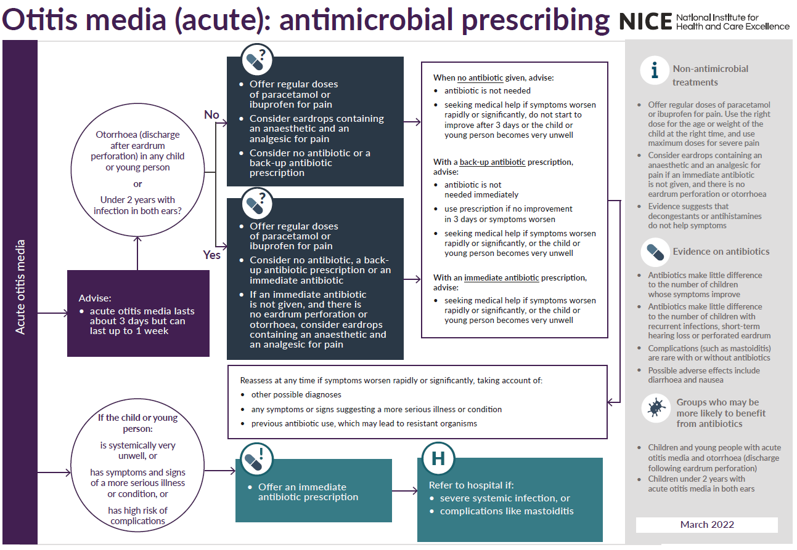
Clinical Scenario
Acute Otitis Media
www.rcgp.org.uk/TARGETantibiotics
NG91: Otitis Media (acute): antimicrobial prescribing
Notes:
This slide shows the NICE antimicrobial prescribing guidance for acute otitis media.
Around 60% of cases resolve within 24 hours without antibiotics.
Antibiotics only slightly reduce pain at two days.
Immediate antibiotics are recommended only if the patient is:
• systemically very unwell
• at high risk of complications
• or has features such as bilateral infection in very young children or otorrhoea.
In most situations antibiotics are unlikely to provide meaningful benefit.
References:
Optimise analgesia:
Little P, Gould C, Williamson I, Moore M, Warner G, Dunleavey J. Pragmatic randomised controlled trial of two prescribing strategies for childhood acute otitis media. BMJ. 2001 Feb; 322(7282):336-342. Available from: http://www.ncbi.nlm.nih.gov/pmc/articles/PMC26576/.
RATIONALE: A randomised controlled trial of 315 children aged between six months and ten years presenting with acute otitis media. Two important observations were noted: parents tend to underestimate the amount of analgesia they have administered, and when recommending a no antibiotic strategy, it is all the more important to optimise analgesia.
Little effect of antibiotics:
Venekamp RP, Sanders S, Glasziou PP, Del Mar CB, Rovers MM. Antibiotics for acute otitis media in children. Cochrane Database Syst Rev. 2015;23:1-85. http://onlinelibrary.wiley.com/doi/10.1002/14651858.CD000219.pub4/epdf.
A systematic review, revealing that antibiotics have no early effect on pain, a slight effect on pain in the days following, and only a modest effect on the number of children with tympanic perforations, contralateral otitis episodes, and abnormal tympanometry findings (at two to four weeks, and six to eight weeks) compared with placebo in children with acute otitis media. In high-income countries, most cases of acute otitis media spontaneously remit without complications. The authors conclude that the benefits of antibiotics must be weighed against the possible harms, eg for every 14 children treated with antibiotics, one child had an adverse event (vomiting; diarrhoea; rash) that would not have occurred if antibiotics not given.
Why under 2 years? The protective immunity against infections with encapsulated bacteria, such as the species that cause AOM, depends on the ability to produce specific antibodies against bacterial capsular polysaccharides, which is inadequate until 2 years of age. The anatomic features of the eustachian tubes and the nasopharynx also differ with age. Consequently, children under 2 years of age seem to be more susceptible to AOM.
The evidence for treating those with more severe symptoms comes from: Rovers MM, Glasziou P, Appleman CL, Burke P, McCormick DP, Damoiseaux RA, Little P, Le Saux N, Hoes AW. Predictors of pain and/or fever at 3 to 7 days for children with acute otitis media not treated initially with antibiotics: a meta-analysis of individual patient data. Pediatrics 2007;119:579-85 RATIONALE: The risk of prolonged illness was 2 times higher for children <2years with bilateral AOM than for children with unilateral AOM. For this sub-group parents should be advised that symptoms may persist for up to 7 days, and they should optimise analgesia use.

Slide 32
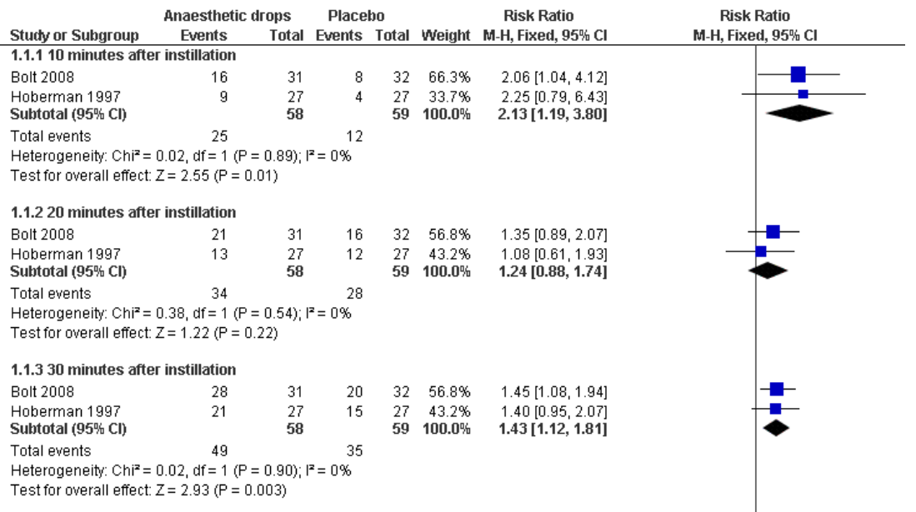

Topical analgesia for acute otitis media
Clinical Scenario
Acute Otitis Media
Anaesthetic versus placebo showed 50%/30% reduction in ear pain 10/30 min after administration
Foxlee et al. Cochrane. (2006) CD005657
Notes:
Recent NICE guidance supports the use of analgesic ear drops when appropriate. Meta-analysis shows that topical anaesthetic drops can significantly reduce pain within 10–30 minutes after administration.
These can therefore be an effective option for managing symptoms in children with acute otitis media
Reference:
Foxlee R, Johansson AC, Wejfalk J, Dooley L, Del Mar CB. Topical analgesia for acute otitis media. Cochrane Database of Systematic Reviews 2006, Issue 3. Art. No.: CD005657. DOI: 10.1002/14651858.CD005657.pub2.
https://www.ncbi.nlm.nih.gov/pmc/articles/PMC9006341/pdf/CD005657.pdf

Slide 33

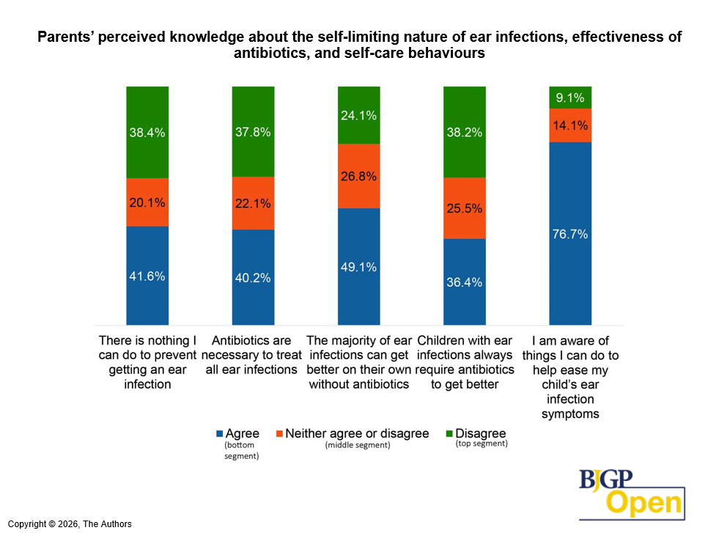
Perceptions towards antibiotics
Catherine V Hayes et al. BJGP Open 2026;BJGPO.2025.0131
Notes:
Clinically we know many of these infections are self-limiting.
A very recent public surveys conducted by UKHSA show that over a third of parents incorrectly assume children always need antibiotics for ear infections.

Slide 34
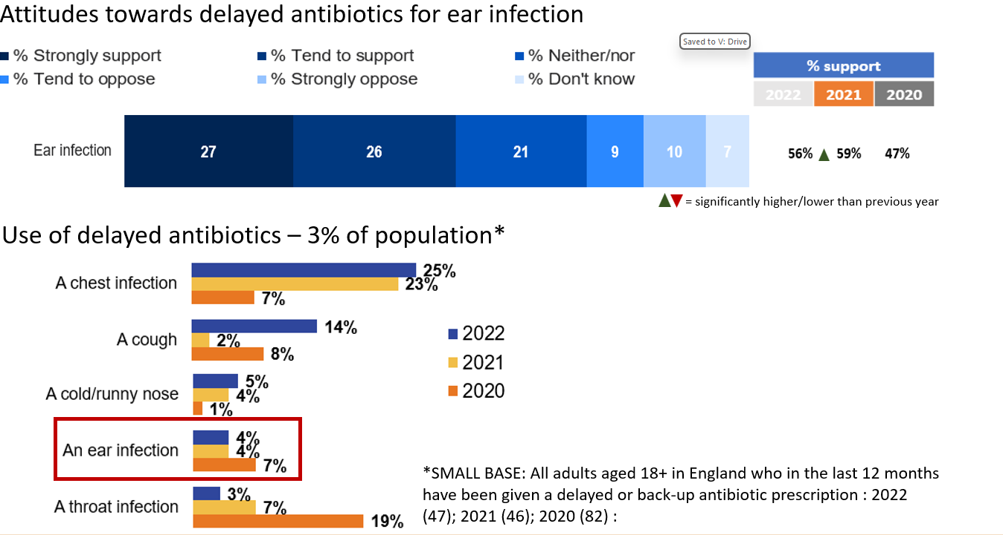
Awareness of delayed/back up prescribing has increased but is still low; acceptance is increasing
Clinical Scenario
Acute Otitis Media
Y2 COVID-19
Y1 COVID-19
Pre COVID-19
Awareness of delayed prescribing has increased
Last review: Feb 2023
Next review: Feb 2026
Base: All adults aged 18+ in England: 2022 (1663), 2021 (1676); 2020 (2052) :
Notes:
An earlier study looked at awareness of delayed prescribing, where an interesting picture emerges.
Awareness increased during the pandemic, but in 2022, around 70% of the public still do not fully understand delayed prescribing.
Acceptance is higher than awareness.
Around 56–59% of people support delayed prescribing for ear infections.
Yet only about 4% of patients actually receive one.
This suggests that patients may be more ready for delayed strategies than our prescribing patterns suggest.

Slide 35
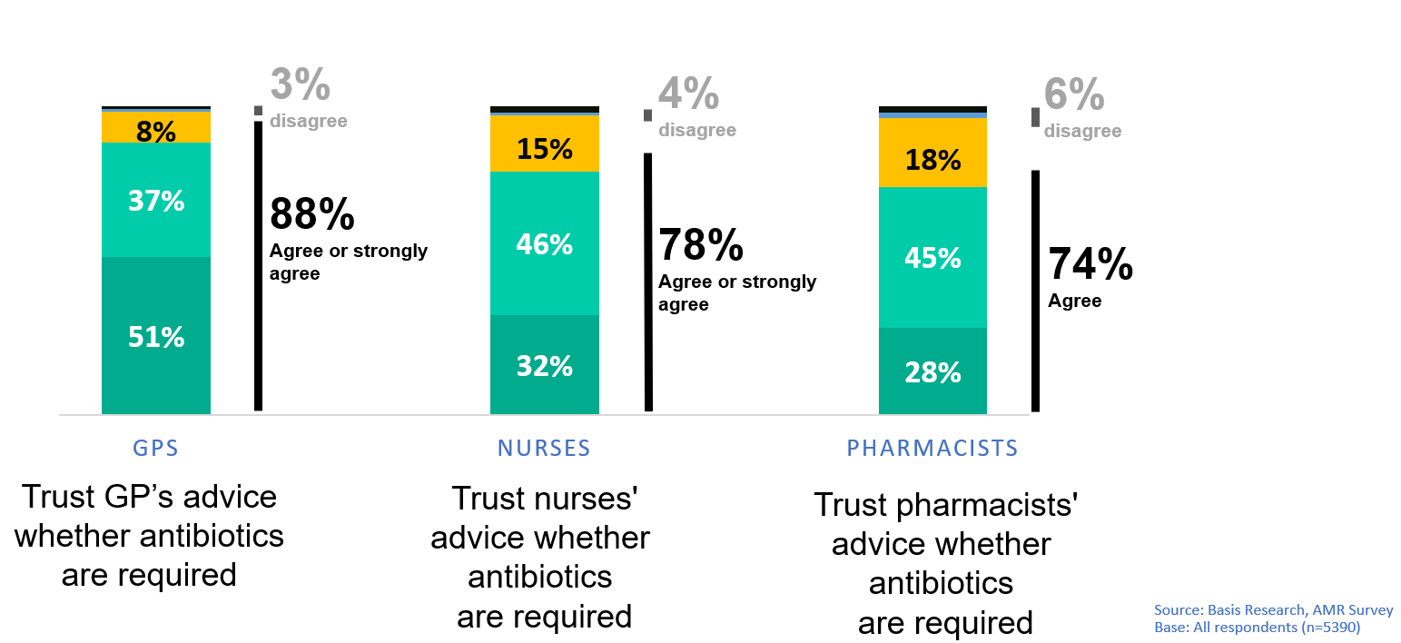
What did you expect from your contact or visit to the Doctor's surgery, for this most recent illness?
Vs What happened when you contacted or visited the Doctor's surgery [multiple choice question]
Patient expectations vs Trust
Significantly higher / lower vs. expectation
(AMR Public Perceptions survey 2023, Basis Research)
Notes:
Patients in that same study were also asked what they expected from consultations.
Around 40% expect antibiotics, but just as many expect symptom relief or reassurance.
And nearly a third expect advice about whether antibiotics are actually needed.
Most importantly, levels of trust are extremely high:
• 88% trust their GP’s advice
• 74% trust their pharmacist’s advice
That trust gives us a real opportunity to practise antimicrobial stewardship safely.
Slide references
UKHSA AMR Public Perceptions survey, Basis Research, December 2023 – Awaiting peer review and publication.

Slide 36
Working as one Primary Care System
Taking a whole team approach
Dr Farida Abdul-Rahmen,
GP & ICB AMR Fellow

Slide 37
Communicating and Escalating across primary care
Utilising TARGET as our shared clinical language
In Community Pharmacy
Apply FeverPAIN within PGD criteria
Use structured AOM criteria
Reinforce delayed prescribing messages
Provide TARGET patient leaflets
Document PGD rationale clearly
In General Practice:
Use FeverPAIN / Centor to structure sore throat assessment
Use NICE-linked criteria for AOM & RTI
Document score + rationale
Issue delayed prescriptions where appropriate
Use TARGET leaflets
www.rcgp.org.uk/TARGETantibiotics

Slide 38
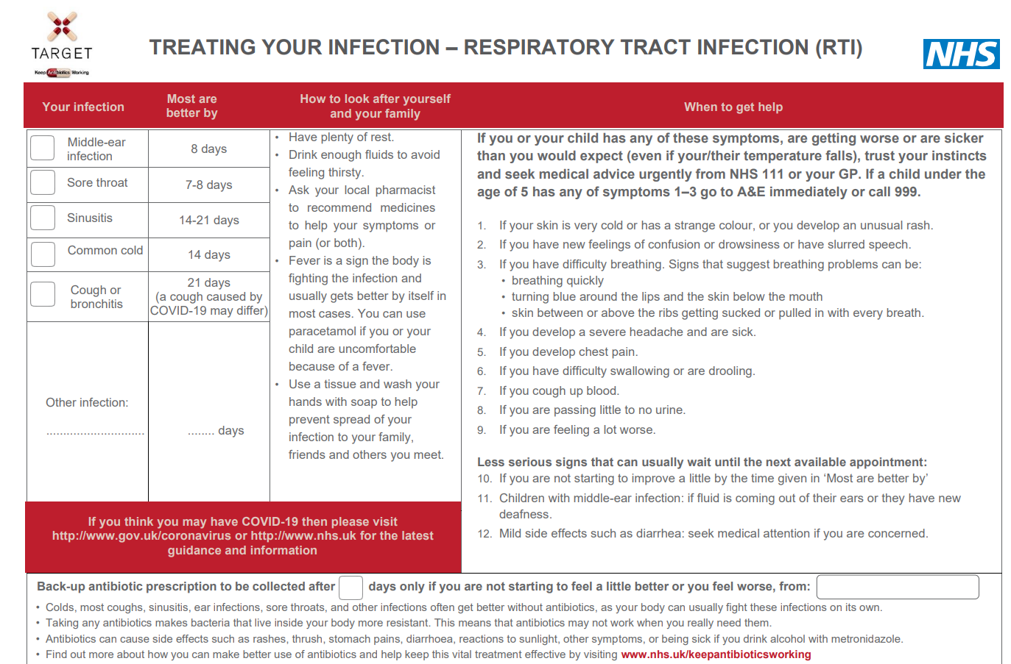
TARGET: Patient Information Leaflets
Treating Your Infection RTI Leaflet
Clinical Scenario
Acute Sore Throat
‘Most are better by’ section to help patients know when to (re) consult
Safety netting
Covid-19 Warning
Back-up prescription
Information about antibiotics & AMR
Resources available in multiple languages to support accessibility
www.rcgp.org.uk/TARGETantibiotics

Slide 39
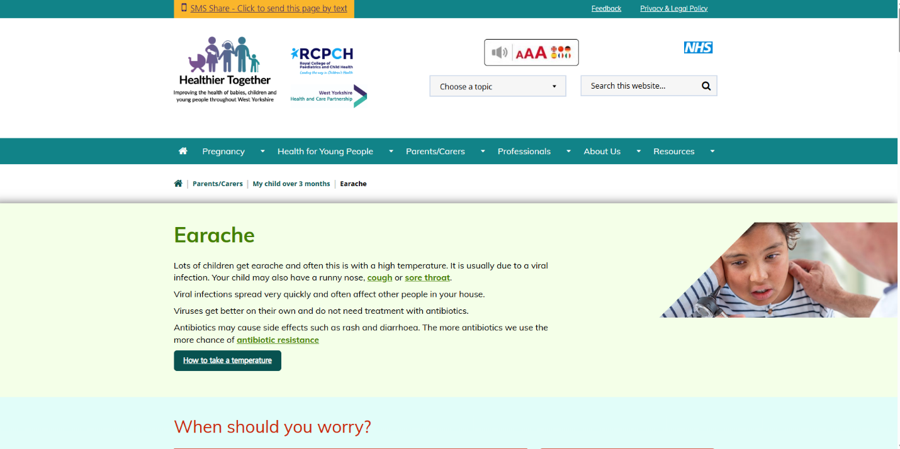
Safety netting - WY Healthier Together
Resources available in multiple languages to support accessibility
https://wyhealthiertogether.nhs.uk
Notes:
Speaker:
Time:
Presenter notes:
One of the simplest ways we strengthen stewardship across primary care is through consistent safety-netting and signposting.
For example, in general practice clinicians may send Healthier Together links directly to parents by text during or after the consultation.
That consistency reduces confusion, reduces unnecessary reattendance, and helps patients feel more confident managing self-limiting infections.

Slide 40
Practical Behaviours that strengthen the GP-Pharmacy Interface
Shared Safety-Netting
Same red flags
Same expected duration messaging
Same escalation triggers
Remember: If its not recorded it didn’t happen
Document clearly and consistently
Clinical scores and findings (e.g. FeverPAIN)
Clinical reasoning and advice given
Pharmacy First pathway / PGD criteria applied
Consultation record shared with GP practice
Support the shared management plan
Reinforce GP advice where relevant
Reinforce delayed antibiotic strategy (if issued)
Support self-care using TARGET resources
www.rcgp.org.uk/TARGETantibiotics

Slide 41
Q&A
Practical Dilemmas from the floor

Slide 42
From Learning to Action
Reducing antibiotic prescribing in your practice
Makes difference to resistance in your patients
Helps to slow future antibiotic resistance
Increase patient self-care
Helps to reduce future consultations

Slide 43
Will you cascade the training?
Who?
When?
Where?
Who will you engage?
Who will you cascade the training to?
When will you begin the cascade?
When do you aim to complete the cascade?
Where will you hold your training sessions?
What?
How?
What barriers might you face and how will you overcome them?
What additional information/data could you include in your training?
What are your next steps?
  How will you tailor the training to suit the needs in your area?
  How will you engage the right people?
  How will you identify opportunities to support the reach and impact of your training cascade?

Slide 44

Post-session survey
Open the link in the email that was sent to you after the pre-session survey
Copy your unique survey code from the email and past it into the survey login screen
You will re-join the survey at the last question you answered. Change this answer to ‘Continue to the post-session survey’
Complete the remainder of the survey
Click ‘Submit’ - you’ll be sent a certificate of completion of training to the email address you entered earlier
https://bit.ly/TARGETtraining
Notes:
Speaker:
Time:
Presenter notes:
Please take a few minutes to complete the post-session survey. I will send this out via email after the session.
Once completed you will receive a certificate which can be used as part of your CPD.
References/links
Pre/post session survey - bit.ly/TARGETcascaded

Slide 45
Thank you

